Slide 1
بسم الله الرحمن الرحیم
Notes:
Introduce yourself
ان شاء الله که وخت خوب و پربرکت خواهیم داشت

Slide 2
JS101 Introduction to Web Programming with Javascript

Slide 3
Welcome
Notes:
Introduce yourself
ان شاء الله که وخت خوب و پربرکت خواهیم داشت

Slide 4
Agenda
Introduction
Course Structure
Algorithms
JavaScript

Slide 5
Introduction
Notes:
Name, education, experience
Ask student to introduce themselves? How many of them have prior programming experience? School or university?

Slide 6
System Software
Application Software
Notes:
System softwares: Operating System, drivers. Controls and manages hardware. Low level langauges like c, c++, assembly.
Application software: doing some human tasks. Word, excel, photoshop, games. Higher level langauges: java, python, javascript.

Slide 7
Desktop Apps

Slide 8




Slide 9
Mobile Apps

Slide 10




Slide 11
Web Apps

Slide 12




Slide 13
Why JavaScript?

Slide 14





Slide 16



Slide 19
What ultimately matters is how to solve problems, and how to learn new languages and tools.

Slide 20
Course Structure
Notes:
teaching: only tells you how to do something
Training: correct your mistakes and guides you through each step.

Slide 21
Couse duration: eight weeks.
each week includes:
One reading assignment
One quiz; and
One coding assignment

Slide 22
Concepts
First lecture
Second lecture
Third Lecture
Deep Dive
Lab
→
→

Slide 23
Outline
Week1: Fundamentals
Week 2: Objects
Week3: Runtime
Week4: DOM and Events
Week5: AJAX
Week6:SPA
Week7: ReactJS Intro
Week8: Thinking in React

Slide 24
Labs
Lab1: RGB
Lab2: Traffic Light
Lab3: Quizzy
Lab4: Todo
Lab5: dictionary
Lab6:
Lab7:
Lab8:

Slide 25
Assignments
Week1: Hello, Mario, Cash
Week2: Readability, Caesar
Week3: Plurality, runoff
Week4: dictionary
Week5: currency
Week6: weather
Week7: To-do
Week8: Flashcards

Slide 26
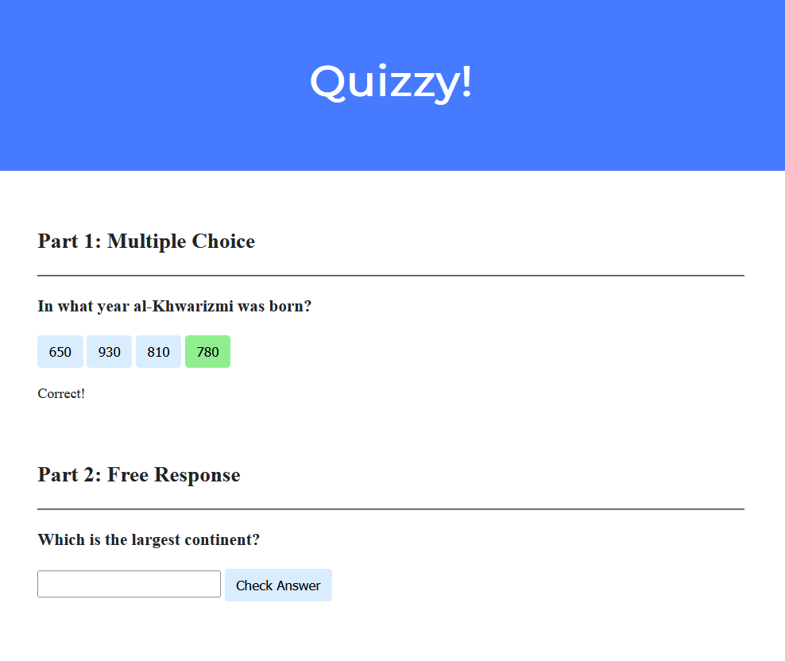

Slide 27
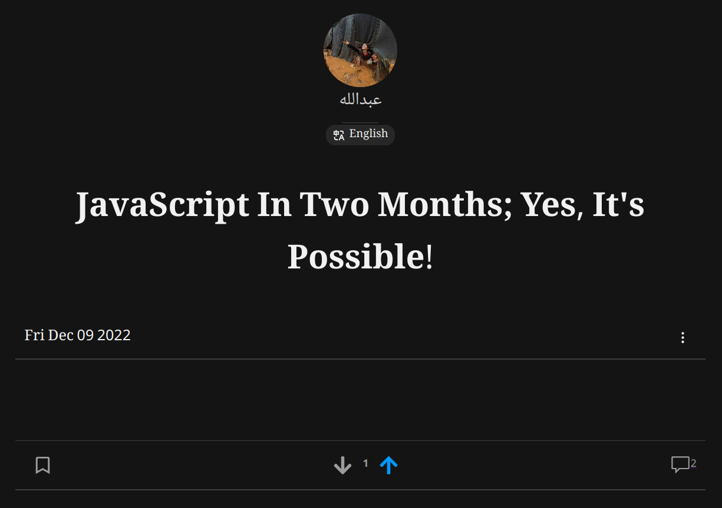
Notes:
You’ll be given the API and interface, you just have to add interactivity and connect it to backend.

Slide 28
Teaching vs Training
Notes:
teaching: only tells you how to do something
Training: correct your mistakes and guides you through each step.

Slide 29
عالم بی عمل – درخت بی ثمر
Notes:
Our teaching philosophy: learn by doing.
چطور در یک شهر نو بلد میشوید.
اول چیز های را یاد بگیر که زیاد سروکار داشته باشی همرایش.
Course suggestion: learning how to learn on Coursera.

Slide 30
what ultimately matters in this course is not so much where you end up relative to your classmates but where
you end up relative to yourself when you began
Notes:
experience that matters is yours
not a competition

Slide 31
Computer Science
Notes:
Introduce yourself
ان شاء الله که وخت خوب و پربرکت خواهیم داشت

Slide 32
input →
Process
→ output
Notes:
Representations: counting on hand, counting with decimal, but computers only have 0s and 1s
Basically computer does 5 basic operations that are input, output, process, storing and controlling.

Slide 33
🖐️

Slide 34
123

Slide 35
1
123

Slide 36
10
1
123

Slide 37
100
10
1
123

Slide 38
100
10
1
123
100 × 1

Slide 39
100
10
1
123
100 × 1
+
10 × 2

Slide 40
100
10
1
123
100 × 1
+
10 × 2
+
1 × 3

Slide 41
100
10
1
123
100
+
20
+
3

Slide 42
123

Slide 43
100
10
1
# # #
Notes:
But why 1, 10, and 100?

Slide 44
10²
10¹
10⁰
# # #

Slide 45
2²
2¹
2⁰
# # #

Slide 46
4
2
1
# # #

Slide 47
4
2
1
000

Slide 48
4
2
1
001

Slide 49
4
2
1
010

Slide 50
4
2
1
011

Slide 51
4
2
1
100

Slide 52
4
2
1
101

Slide 53
4
2
1
110

Slide 54
4
2
1
111

Slide 55
A

Slide 56
65

Slide 57
01000001

Slide 58
ASCII

Slide 59
... | A | B | C | D | E | F | G | H | I | ...
... | 65 | 66 | 67 | 68 | 69 | 70 | 71 | 72 | 73 | ...

Slide 60
72 | 73 | 33

Slide 61
H | I
72 | 73 | 33
Notes:
Call-on

Slide 62
H | I | !
72 | 73 | 33

Slide 63
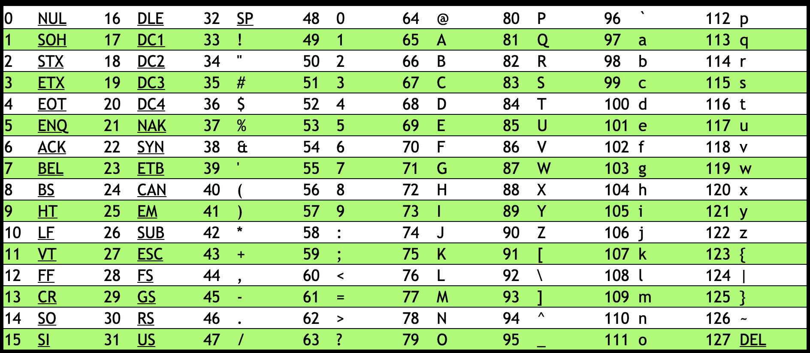
Notes:
https://asciichart.com/

Slide 64
H | I | !
72 | 73 | 33

Slide 65
H | I | !
01001000 | 01001001 | 00100001
Notes:
bytes

Slide 66
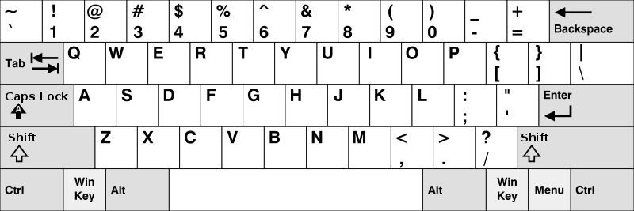
Notes:
https://en.wikipedia.org/wiki/British_and_American_keyboards
But how to represent other symbols?

Slide 67
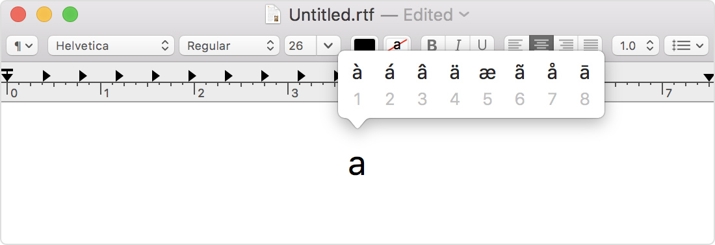
Notes:
https://support.apple.com/en-us/HT201586

Slide 68
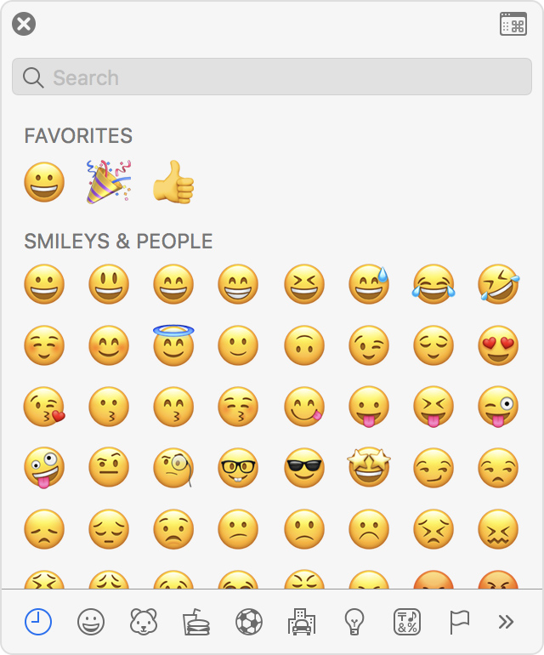
Notes:
https://support.apple.com/en-us/HT201586

Slide 69
Unicode

Slide 70
4,036,991,159

Slide 71
11110000 10011111 10011000 10110111

Slide 72

Notes:
https://emojipedia.org/face-with-medical-mask/
Google

Slide 73

Notes:
https://emojipedia.org/face-with-medical-mask/
Apple

Slide 74
Notes:
Should be #484921ff, but brightened for projectors.

Slide 75
RGB

Slide 77
72 | 73 | 33

Slide 78
72 | 73 | 33

Slide 80
Notes:
Should be #484921ff, but brightened for projectors.

Slide 81


Slide 82


Slide 83


Slide 84
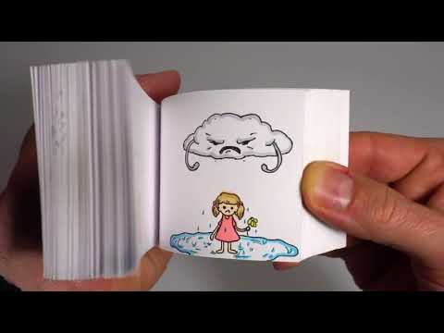
Notes:
https://youtu.be/p3q9MM__h-M

Slide 85
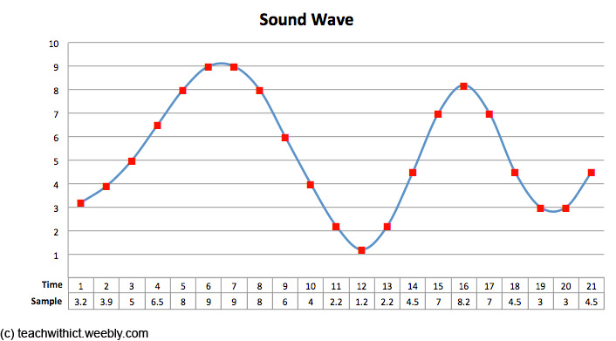
Notes:
note, duration, volume

Slide 86
input →
→ output

Slide 87
algorithm

Slide 88
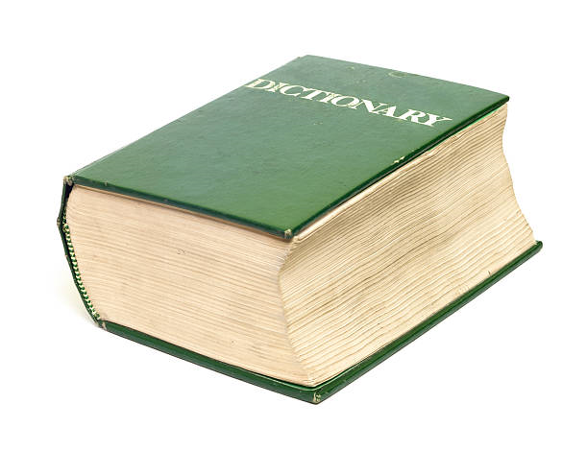
Notes:
https://apps.apple.com/us/app/contacts/id1069512615#?platform=iphone

Slide 89
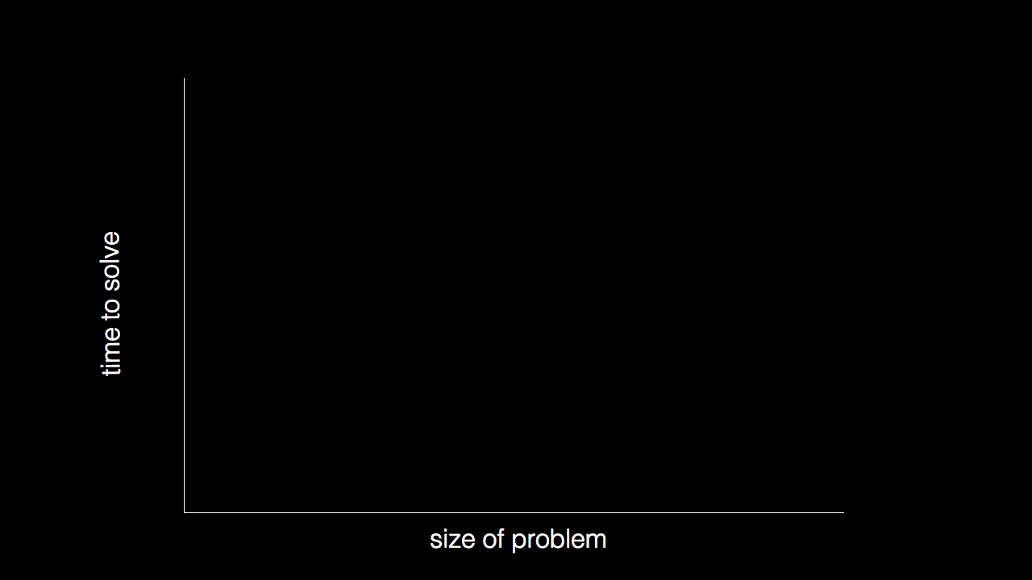

Slide 90
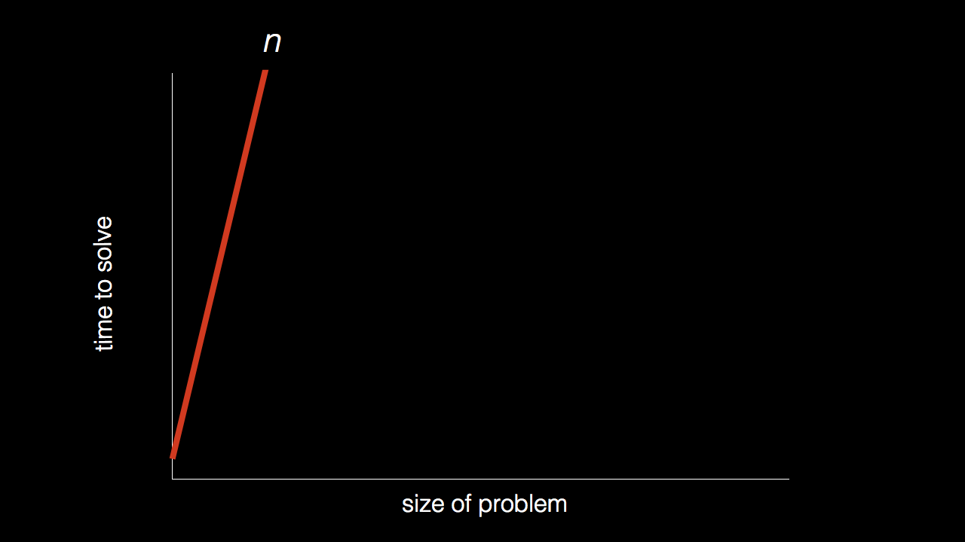
n

Slide 91
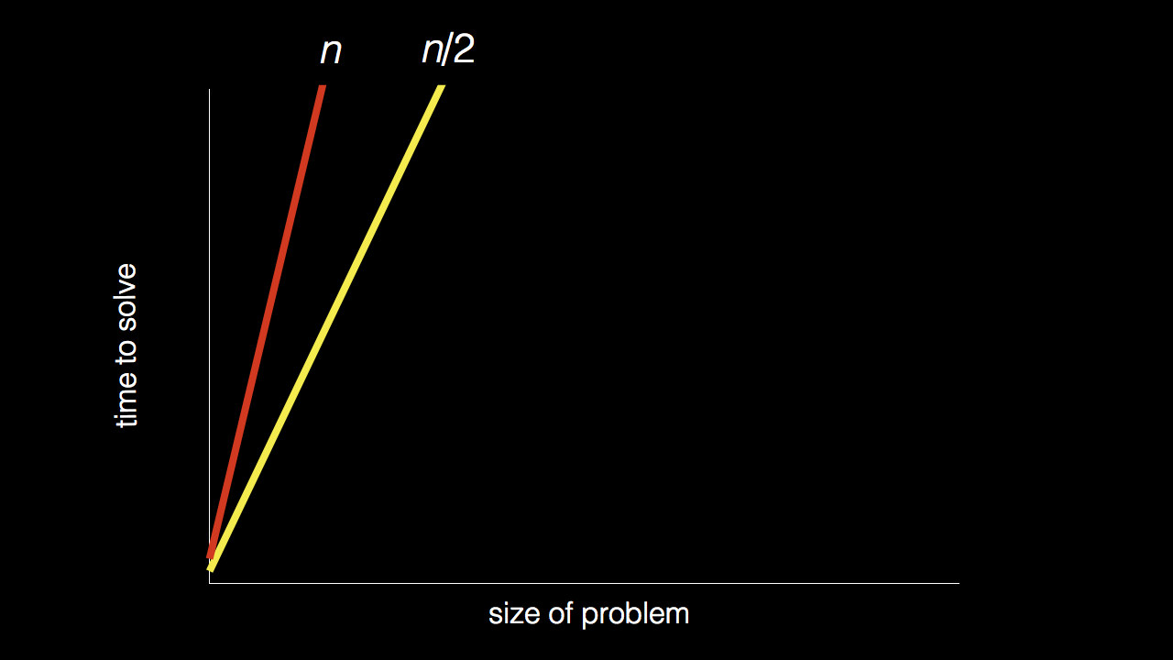
n
n/2

Slide 92
n
n/2

Slide 93
n
n/2

Slide 94
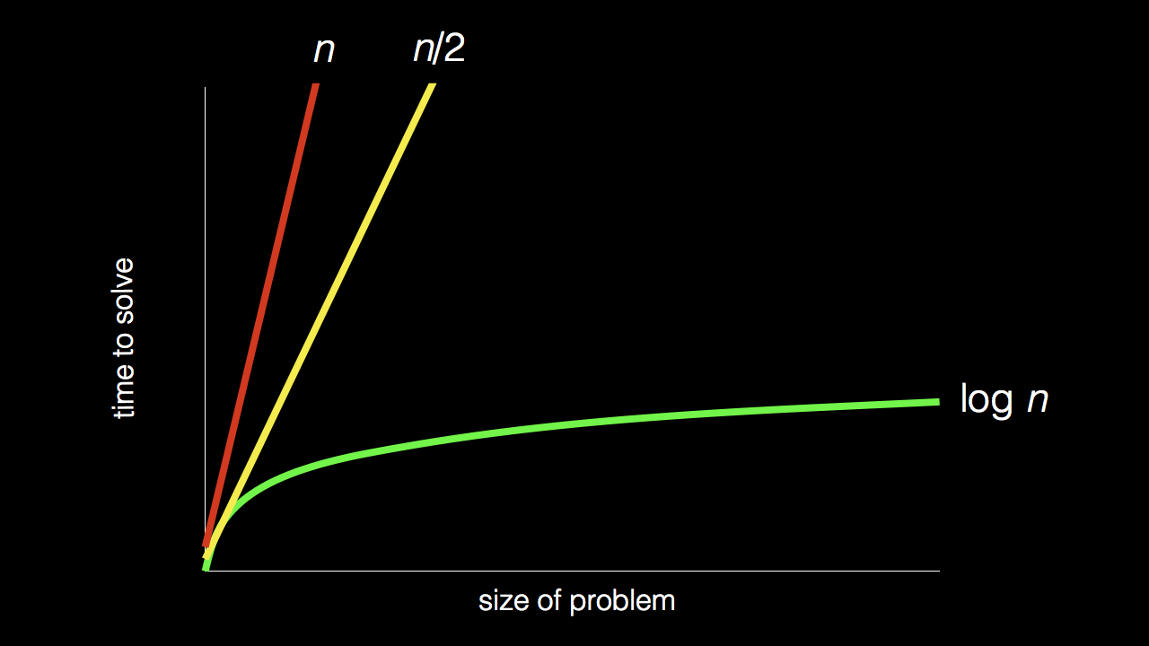
n
n/2
log₂ n

Slide 95
pseudocode

Slide 96
1 Pick up dictionary
2 Open to middle of dictionary
3 Look at page
4 If word is on page
5 Read the Definition
6 Else if word is earlier in dictionary
7 Open to middle of left half of dictionary
8 Go back to line 3
9 Else if word is later in dictionary
10 Open to middle of right half of dictionary
11 Go back to line 3
12 Else
13 Quit

Slide 97
1 Pick up dictionary
2 Open to middle of dictionary
3 Look at page
4 If word is on page
5 Read the Definition
6 Else if word is earlier in dictionary
7 Open to middle of left half of dictionary
8 Go back to line 3
9 Else if word is later in dictionary
10 Open to middle of right half of dictionary
11 Go back to line 3
12 Else
13 Quit

Slide 98
1 Pick up dictionary
2 Open to middle of dictionary
3 Look at page
4 If word is on page
5 Read the Definition
6 Else if word is earlier in dictionary
7 Open to middle of left half of dictionary
8 Go back to line 3
9 Else if word is later in dictionary
10 Open to middle of right half of dictionary
11 Go back to line 3
12 Else
13 Quit

Slide 99
1 Pick up dictionary
2 Open to middle of dictionary
3 Look at page
4 If word is on page
5 Read the Definition
6 Else if word is earlier in dictionary
7 Open to middle of left half of dictionary
8 Go back to line 3
9 Else if word is later in dictionary
10 Open to middle of right half of dictionary
11 Go back to line 3
12 Else
13 Quit

Slide 100
1 Pick up dictionary
2 Open to middle of dictionary
3 Look at page
4 If word is on page
5 Read the Definition
6 Else if word is earlier in dictionary
7 Open to middle of left half of dictionary
8 Go back to line 3
9 Else if word is later in dictionary
10 Open to middle of right half of dictionary
11 Go back to line 3
12 Else
13 Quit

Slide 101
1 Pick up dictionary
2 Open to middle of dictionary
3 Look at page
4 If word is on page
5 Read the Definition
6 Else if word is earlier in dictionary
7 Open to middle of left half of dictionary
8 Go back to line 3
9 Else if word is later in dictionary
10 Open to middle of right half of dictionary
11 Go back to line 3
12 Else
13 Quit

Slide 102
functions
arguments, return values
conditionals
Boolean expressions
loops
variables
...

Slide 103
Let dictionary;

Slide 104
function pickup()
{
}

Slide 105
if()
{
}
else
{
}

Slide 106
While()
{
}

